Slide 1
Discrete Mathematics Counting
by Akkradach W.
Dept. of Computer Engineering
KMITL

Slide 2
Agenda
Chapter 5
The Basics of Counting
The Pigeonhole Principle
Permutations and Combinations

Slide 3
The Basics of Counting
The Product Rule
A sequence of two tasks
n₁ ways for the first, n₂ ways for the last
Then there are n₁n₂ ways to do so
|A₁× A₂ × … × A_{m}|=|A₁|⋅|A₂| ⋅ … ⋅ |A_{m}|
The Sum Rule
A task with two either n₁ ways or n₂ ways
None of first is the same as any of the last
Then there are n₁+n₂ ways to do so
|A₁ ∪ A₂ ∪ … ∪ A_{m}|=|A₁|+|A₂| + … +|A_{m}|

Slide 4
Examples
Telephone Numbering Plan
Nested Loops
Choose one of many distinct lists
Sequenced Loops
Possible Passwords
Counting Internet Address (IPv4)

Slide 5
More complex issues
Inclusion-Exclusion Principle
|A₁ ∪ A₂ |=|A₁|+|A₂| −|A₁ ∩ A₂|
Tree Diagrams

Slide 6
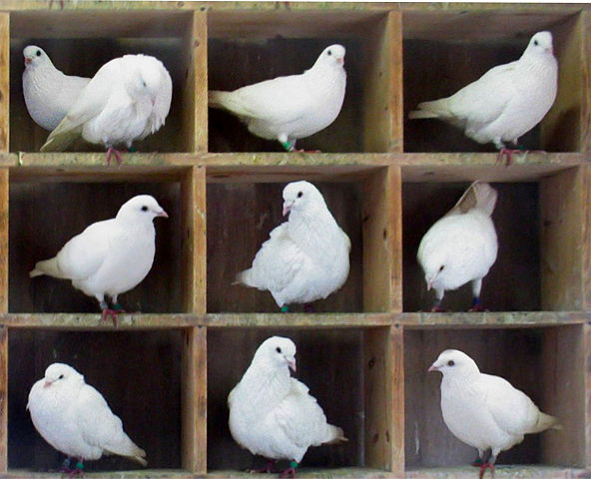
The Pigeonhole Principle
If k is a positive integer and k+1 or more objects are placed into k boxes, then there is at least one box containing two or more of the objects
If N objects are placed into k boxes, then there is a least one box containing at least ⎡N/k⎤ objects

Slide 7
Permutations and Combinations
n ∈ Z⁺, 0 ≤ r ≤ n
Permutation (ordered)
r-Permutation
P(n, r) = n!/(n-r)!
P(n, 0) = 1
Combination (unordered)
r-Combination, Binomial Coefficient
C(n, r) = n!/[(n-r)!r!]
C(n, r) = C(n, n-r)

Slide 8
… with Repetition
r-Permutations of a set of n objects with repetition allowed is n^{r}
r-Combinations of a set of n objects with repetition allowed is C(n+r-1, r)

Slide 9
P() & C() w/ OR w/o Rep
r-Permutations
r-Combinations
r-Permutations with Repettion
r-Combinations with Repettion

